Slide 1
Factors Influencing the Location of Production
BENEDEK László

Slide 2
Overview
Availability of Resources
Infrastructure
Market Access
Government Policies and Regulations
Competition
Cultural and Social Factors

Slide 3
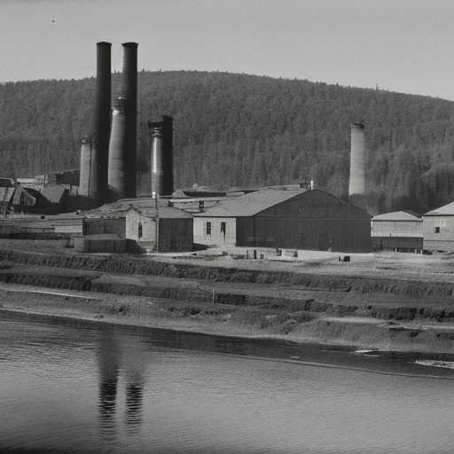
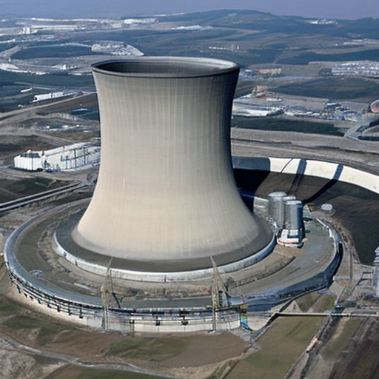
Availability of Resources
Raw materials
Labor
Energy

Slide 4
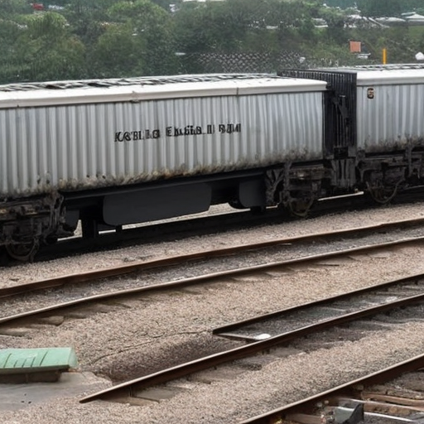
Infrastructure
Transportation
Communication
Energy

Slide 5
Market access
Target customers
Suppliers

Slide 6
Government policies
Tax incentives
Labor laws
Environmental regulations

Slide 7
Competition
Nearer?
Similar resources
Established markets
Farther?
Less competition
Cheaper labor

Slide 8
Cultural and social factors
Language
Customs
Lifestyles

Slide 9
Conclusion
Many factors
Depends on the company’s needs
Efficiency
Profits

Slide 10
Thank you for your attention!

